Slide 1

Coding
Robotics
Games and Apps Development
INTRODUCTION TO TEACHABLE MACHINE WITH GOOGLE
MACHINE LEARNING
…Nurturing STEM Skills for the future
www.brainiacs.com.ng
Learn, Play, Innovate

Slide 2

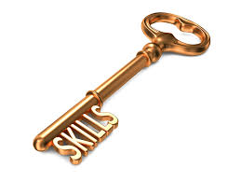
Key Skills to Learn
Creativity.
Critical Thinking.
Problem solving.
Communication
Digital Literacy
Collaboration
www.brainiacs.com.ng
Learn, Play, Innovate

Slide 3
Learning Objectives
At the end of the lesson the pupils should be able to:
Explain what Teachable Machine is and how it works.
Identify real-life applications of machine learning.
Train a simple Teachable Machine model using images.
Test and analyze how AI makes predictions based on patterns.
Export Machine Learning Model.
www.brainiacs.com.ng
Learn, Play, Innovate

Slide 4
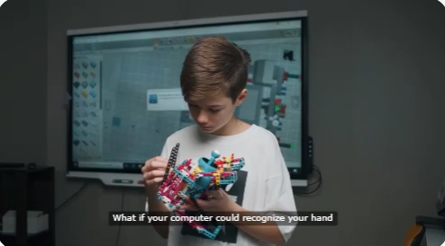
Wow Factor
www.brainiacs.com.ng
Learn, Play, Innovate

Slide 5
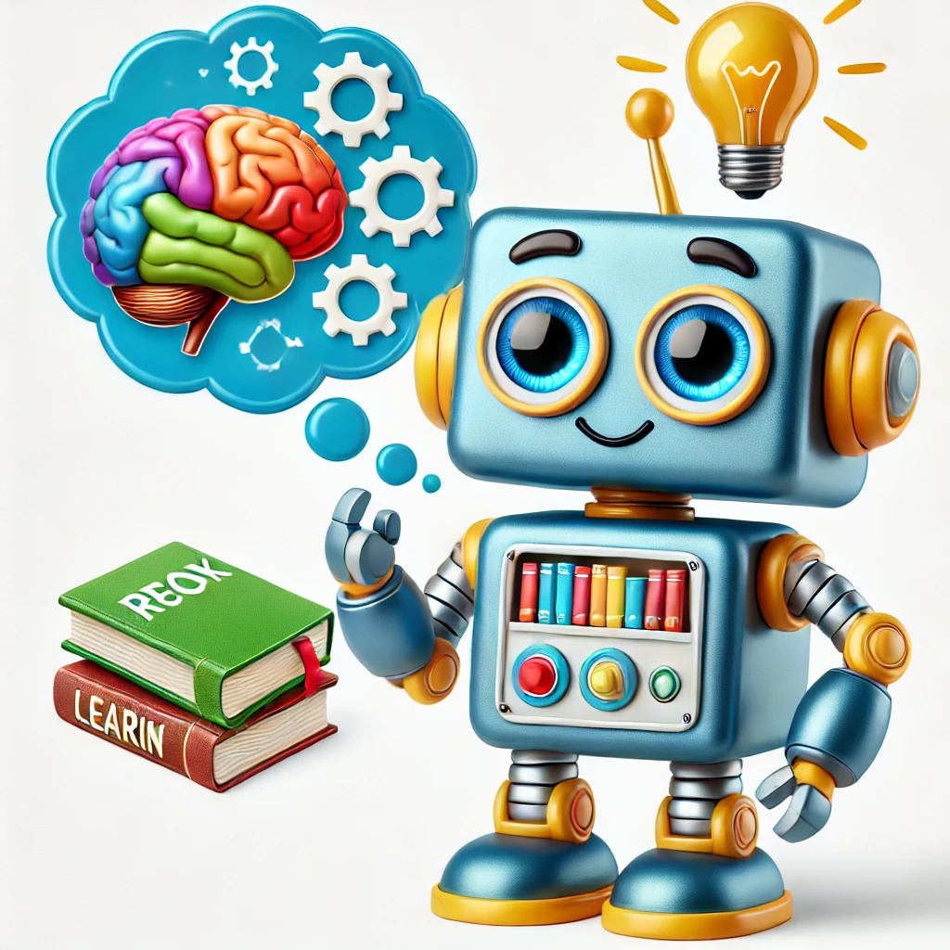
What is AI?
Artificial Intelligence (AI) is when computers and machines learn to think and make decisions like humans. Instead of just following instructions like a normal computer program, AI can recognize patterns, solve problems, and even learn from mistakes!
www.brainiacs.com.ng
2
Learn, Play, Innovate

Slide 6
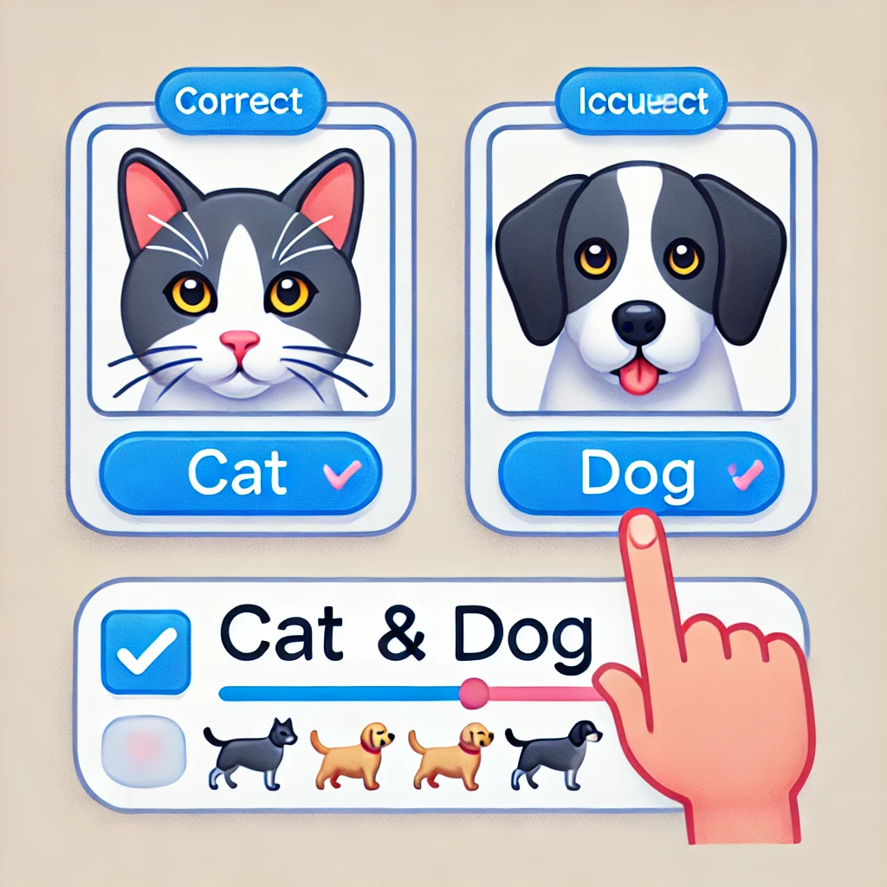
What is Machine Learning (ML)?
Machine Learning (ML) is a type of Artificial Intelligence (AI) that allows computers to learn from data and experience—just like humans learn from practice!
Instead of being programmed step by step, a machine learning model looks at lots of examples, finds patterns, and makes decisions on its own.
www.brainiacs.com.ng
2
Learn, Play, Innovate

Slide 7
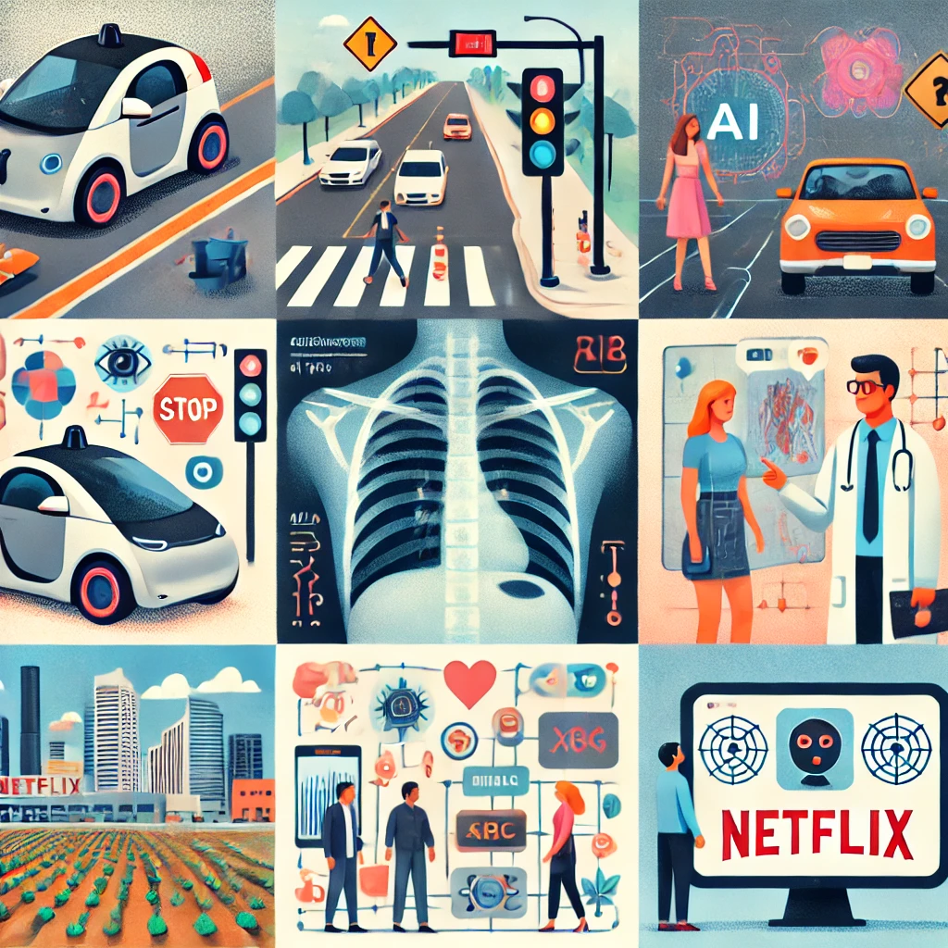
Application of Machine Learning
Machine learning has several real-world application and could be found in the following areas below;
Self driving vehicles
Healthcare for medical diagnosis
Agriculture for precision farming
Facial recognition in smartphones and computers
Smart Assistants (AI chatbots and Voice recognition)
E-commerce
www.brainiacs.com.ng
Learn, Play, Innovate

Slide 8
Introduction to Teachable Machine
Teachable Machine is an online web-based tool designed by Google to allow anyone train machine learning models easily even without have any coding experience. It helps people understand how artificial intelligence (AI) learns by recognizing patterns in images, sounds, and body movements.
It is also a fun and interactive way to explore machine learning (ML) through teaching computers how to recognize things just like humans do.
www.brainiacs.com.ng
Learn, Play, Innovate

Slide 9
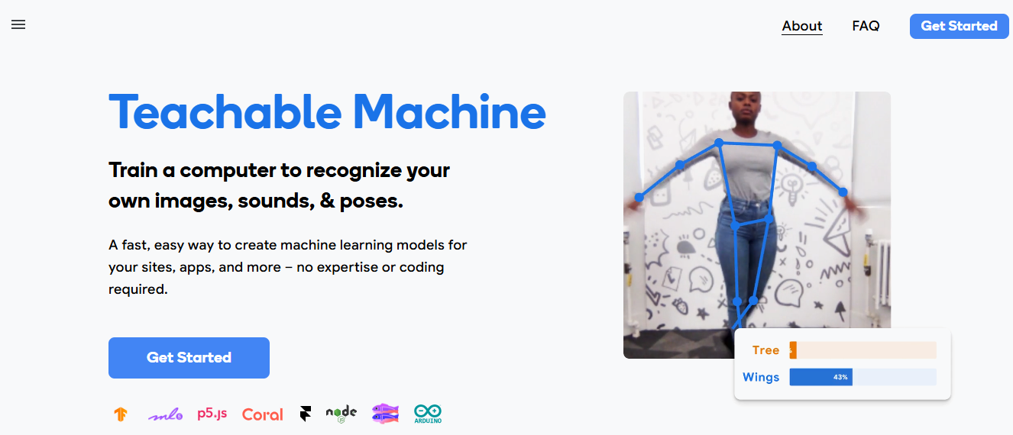
Steps to Train A Data Model on Google Teachable Machine
STEP 1: Open the Google Teachable Machine platform by clicking on the link below:
https://teachablemachine.withgoogle.com/
STEP 2: Click on ‘Get Started’
www.brainiacs.com.ng
Learn, Play, Innovate

Slide 10
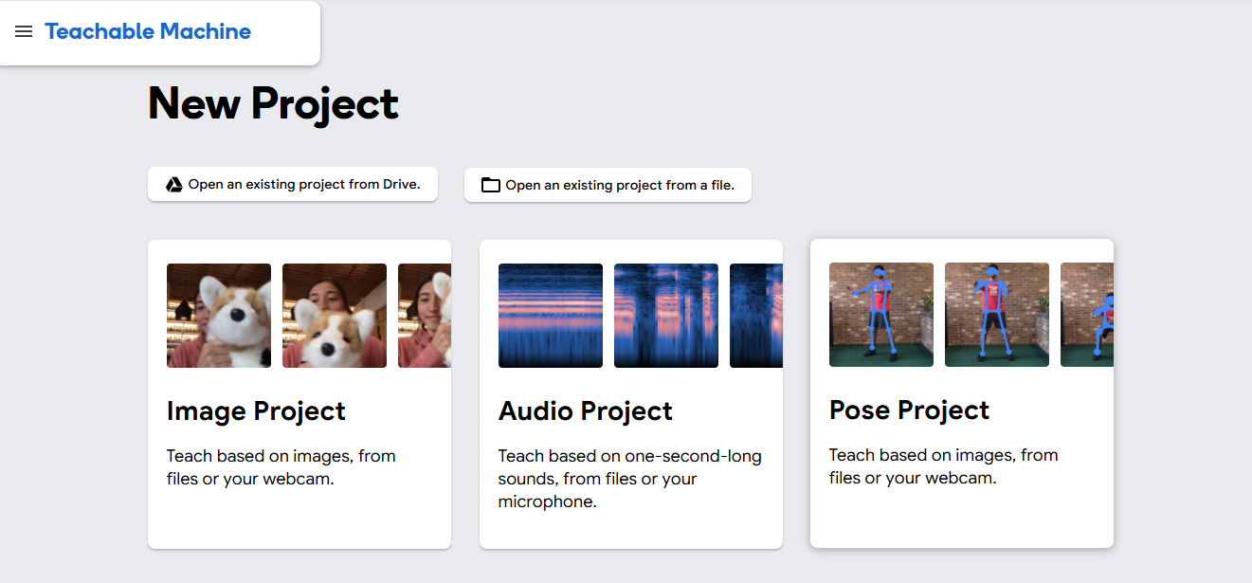
Steps to Train A Data Model on Google Teachable Machine
STEP 3: Click on Image Project
www.brainiacs.com.ng
Learn, Play, Innovate

Slide 11
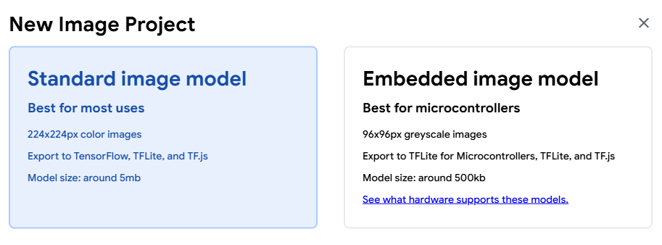
Steps to Train A Data Model on Google Teachable Machine
STEP 4: Click on Standard image model
www.brainiacs.com.ng
Learn, Play, Innovate

Slide 12
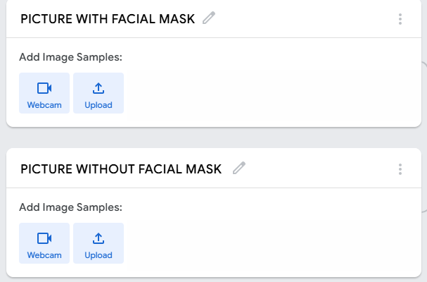
Steps to Train A Data Model on Google Teachable Machine
STEP 4: Click here to rename your model
STEP 5: Click here to either use webcam or upload your images,
www.brainiacs.com.ng
Learn, Play, Innovate

Slide 13
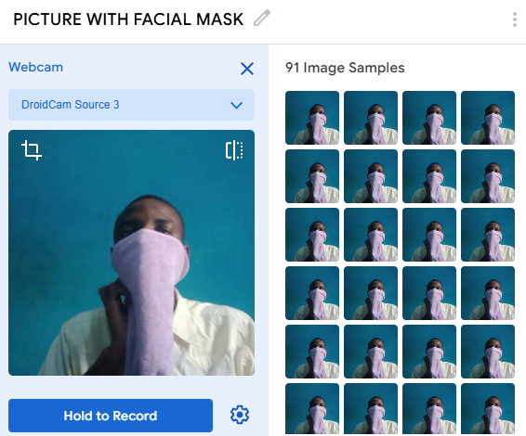
Steps to Train A Data Model on Google Teachable Machine
STEP 6: Click here to record as many images as possible with facial mask
www.brainiacs.com.ng
Learn, Play, Innovate

Slide 14
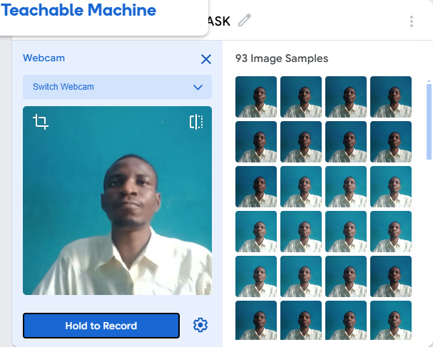
Steps to Train A Data Model on Google Teachable Machine
STEP 7: Choose the second task and record as many images as possible
www.brainiacs.com.ng
Learn, Play, Innovate

Slide 15
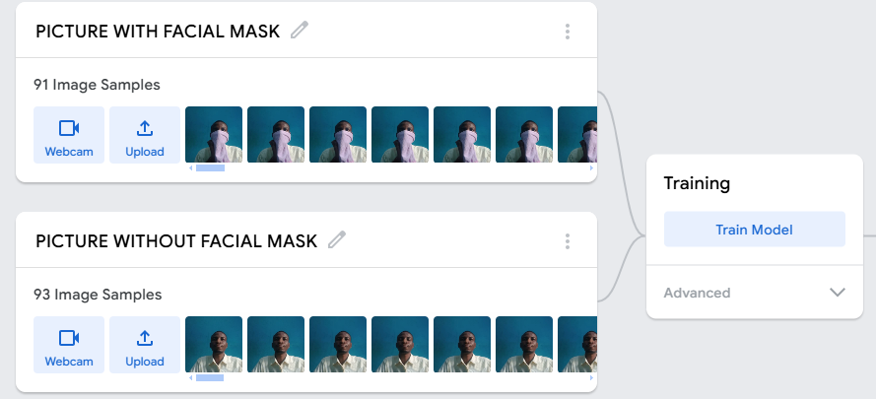
Steps to Train A Data Model on Google Teachable Machine
STEP 8: Immediately you are satisfied with recorded or uploaded images, click here to train your model and remember not to switch tab while training your model
www.brainiacs.com.ng
Learn, Play, Innovate

Slide 16
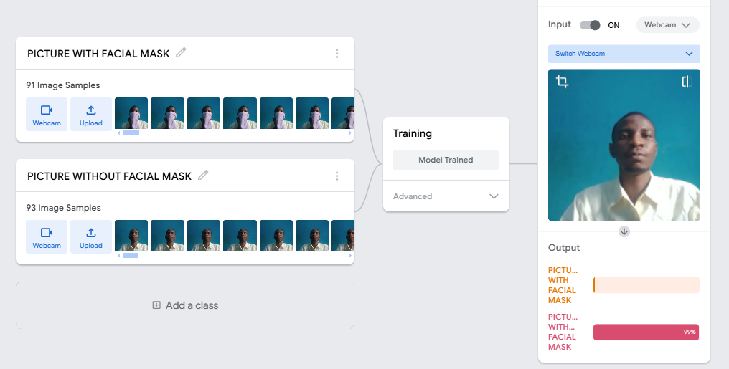
Steps to Train A Data Model on Google Teachable Machine
STEP 9: After successfully training your model, face the webcam to check the accuracy of the output.
www.brainiacs.com.ng
Learn, Play, Innovate

Slide 17
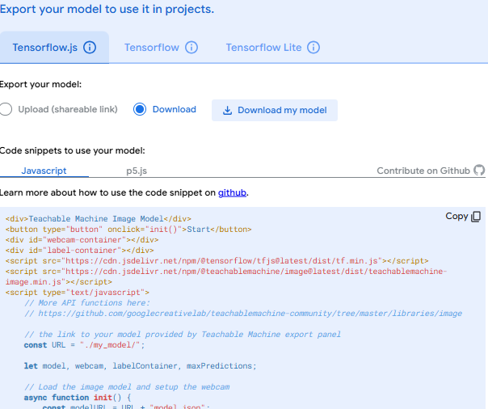

Exporting A Data Model on Google Teachable Machine
STEP 5: Click here to finally download your model for future use
STEP 1: Upon being satisfied with your model output click here to export your model
www.brainiacs.com.ng
Learn, Play, Innovate

Slide 18

Lesson Outcomes
Learners can,
Students understand AI and machine learning basics.
They successfully train and test their own Teachable Machine model.
They reflect on AI's role in everyday life and future possibilities.
They develop curiosity and excitement about technology and innovation.
www.brainiacs.com.ng
Learn, Play, Innovate

Slide 19
End of Lesson
19
www.brainiacs.com.ng
Learn, Play, Innovate
Notes:
Sing we are Brainiacs while engaging the children

Slide 20
How you can get to us
20
Twitter: Brainiacs_Ng
Phone No: +234 909 109 5057
Email: brainiacsng@gmail.com
info@brainiacs.com.ng
Website: www.brainiacs.com.ng
google+: brainiacsng
Youtube Channel: Brainiacs_Ng
www.brainiacs.com.ng
Learn, Play, Innovate

Slide 21

21
Well-done!
www.brainiacs.com.ng
Learn, Play, Innovate

